Slide 1
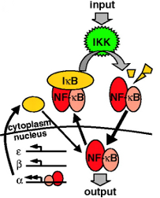
NF-κB
Modelling Across Scales:
From Molecules to Pandemics
Week 3: Cancer
Notes:
Week 3: Cancer Modelling
Workshop - Cancer modelling from small mutations, through signalling pathways, to large changes in cells.
- Practical: running your first cancer model.
Week 4: Cancer Modelling:
Workshop - Key signalling pathways in lymphoma and how we model them.
- Practical: using a model to predict which mutations might contribute to cancer pathology

Slide 2
Notes:
What do I do? There are lots of pathways in the cell and you can simulate them to get information. Using computers and models.
Hoffman 2002 model: what is a model? It’s equations and rates.
There are several published models. We are using 2002 today. NF-κB has been modelled in 2014, other times…….
Expalin that negative feedback is something creating its own inhibitor and inhibitor is inhibiting its creator.
This network has evolved not to fizzle out, but to go up and down and make healthy response.
Need IKK to be high to stop it fizzling out. IKK is high in response to bacteria.
Hoffman prove that it looks like this using western blots in the lab.
Beta nad epsilon are there, their purpose is to make it dampen,.
Substrate enzyme complex on the methods ODE bit.

Slide 3
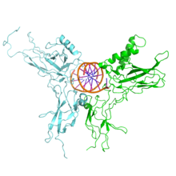
Previously on SSC 104
Population level models of infection - SEIR
“Agent based” multi-cell model – cells live, divide, and die
Today: single pathway in immune system

Slide 4
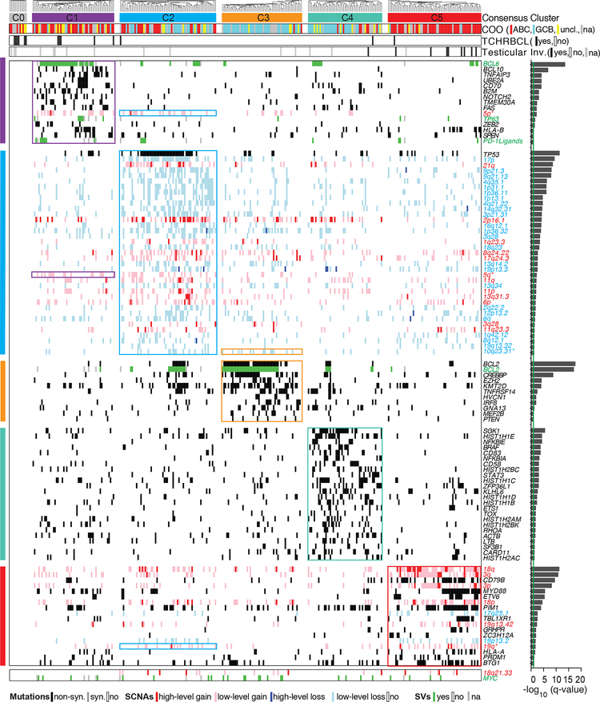
Chapuy et al, Molecular subtypes of diffuse large B cell lymphoma are associated with distinct pathogenic mechanisms and outcomes. Nat Med. 2018

Slide 5
Nuclear Factor –κappa B
Transcription factor which regulates Immunity
Responds to immune receptors including BCR, TLR
And developmental signals: BAFFR, CD40, RANK, TNFR2
Is Upregulated in lymphoma and other cancers.
Chronically high NF- κB Increases cancer cell survival
Poorer prognosis
B CELL FATE is controlled by NF-κB

Slide 6
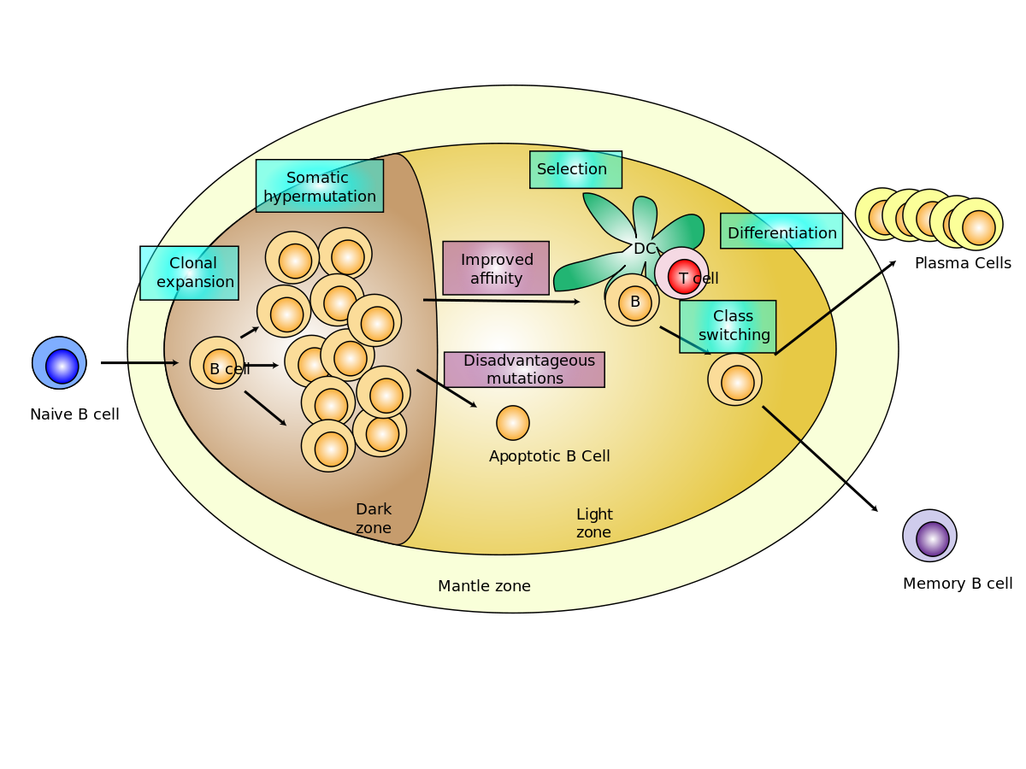
Nuclear Factor –κappa B
NF-κB gradient
Notes:
cRel to RelA
However that’s more complicated NF-κB than we can cover in one go.

Slide 7
What it responds to
Transcription factor which regulates Immunity
Responds to immune receptors including BCR, TLR
And developmental signals
Controls Cell Fate
Is Upregulated in lymphoma and other cancers.
Chronically high NF- κB Increases cancer cell survival
Poorer prognosis

Slide 8
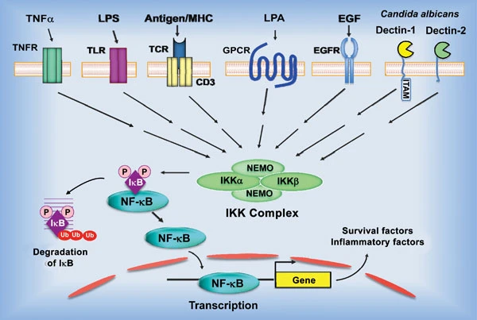
Blonska, M., Lin, X. NF-κB signaling pathways regulated by CARMA family of scaffold proteins. Cell Res 21, 55–70 (2011). https://doi.org/10.1038/cr.2010.182

Slide 9
Nuclear Factor –κappa B
One mutation is usually insufficient to cause cancer
Chronically High NF-κB dysregulates cell fate in B cells and conveys a poorer prognosis.
NF-κB is regulated by many proteins, so many upstream signalling network proteins could be sites of a driver mutation.
e.g. CARD11 F123I and Myd88 L265P
Notes:
Cell fate dysregulation: pushes a B cell into a weird differentiation space. (Waldenstrom’s landscape.?) A cancer cell is “off the rails” its expression profile and metabolite concentrations are likely bizarre.

Slide 10
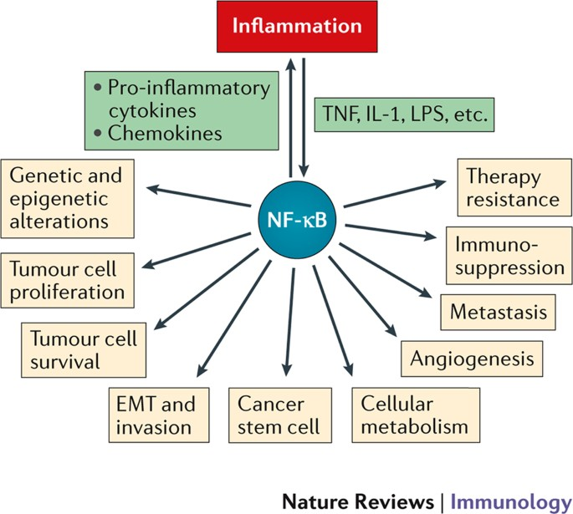
Nuclear Factor –κappa B

Slide 11
Hoffman et al. 2002
IKK receives signal from Toll Like Receptors and B Cell Receptors
Active IKK phosphorylates IκB, signalling for its destruction.
NF-κB is released and migrates into the nucleus
When IκB levels rise again, they will bind and “pull” NF-κB back out of the nucleus
Notes:
Hoffman 2002: there are several models of NF-κB signalling, this one is nice and small. It only contains a few protein species.

Slide 12
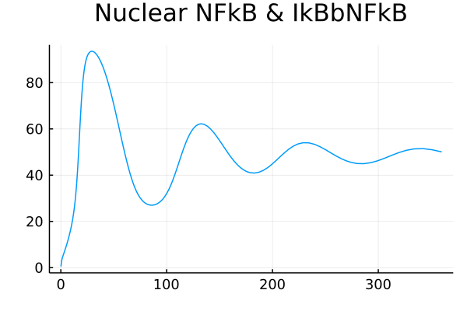
INPUT
IKK
IκBα
NF-κB
IκBε
NF-κB
NF-κB
IκBβ
NF-κB
Cytoplasm
Nucleus
IκBα
NF-κB
IκBε
α
NF-κB
IκBβ
ε
β
OUTPUT
Notes:
So, NF-kappaB is removed from the nucleus at a rate proportional to IkB proteins!!
These models work on Mass Action, i.e. the rate of change is proportional to all the actors.

Slide 13
INPUT
IKK
IκBα
NF-κB
IκBε
NF-κB
NF-κB
IκBβ
NF-κB
Cytoplasm
Nucleus
IκBα
NF-κB
IκBε
α
NF-κB
IκBβ
ε
β
OUTPUT
Notes:
So, NF-kappaB is removed from the nucleus at a rate proportional to IkB proteins!!
These models work on Mass Action, i.e. the rate of change is proportional to all the actors.

Slide 14
IκBα
NF-κB
IκBε
NF-κB
NF-κB
IκBβ
NF-κB
Cytoplasm
Nucleus
IκBα
NF-κB
IκBε
α
NF-κB
IκBβ
ε
β
OUTPUT
Notes:
So, NF-kappaB is removed from the nucleus at a rate proportional to IkB proteins!!
These models work on Mass Action, i.e. the rate of change is proportional to all the actors.

Slide 15
INPUT
IKK
IκBα
NF-κB
IκBε
NF-κB
NF-κB
IκBβ
NF-κB
Cytoplasm
Nucleus
IκBα
NF-κB
IκBε
α
IκBβ
ε
β
OUTPUT
Notes:
So, NF-kappaB is removed from the nucleus at a rate proportional to IkB proteins!!
These models work on Mass Action, i.e. the rate of change is proportional to all the actors.

Slide 16
INPUT
IKK
IκBα
NF-κB
IκBε
NF-κB
NF-κB
IκBβ
NF-κB
Cytoplasm
Nucleus
IκBα
NF-κB
IκBε
α
NF-κB
IκBβ
ε
β
OUTPUT
Notes:
So, NF-kappaB is removed from the nucleus at a rate proportional to IkB proteins!!
These models work on Mass Action, i.e. the rate of change is proportional to all the actors.

Slide 17
INPUT
IKK
IκBα
NF-κB
IκBε
NF-κB
NF-κB
IκBβ
NF-κB
Cytoplasm
Nucleus
IκBα
NF-κB
IκBε
α
NF-κB
IκBβ
ε
β
OUTPUT
Notes:
So, NF-kappaB is removed from the nucleus at a rate proportional to IkB proteins!!
These models work on Mass Action, i.e. the rate of change is proportional to all the actors.

Slide 18
INPUT
IKK
IκBα
NF-κB
IκBε
NF-κB
NF-κB
IκBβ
NF-κB
Cytoplasm
Nucleus
IκBα
NF-κB
IκBε
α
NF-κB
IκBβ
ε
β
OUTPUT
Notes:
So, NF-kappaB is removed from the nucleus at a rate proportional to IkB proteins!!
These models work on Mass Action, i.e. the rate of change is proportional to all the actors.

Slide 19
INPUT
IKK
IκBα
NF-κB
IκBε
NF-κB
NF-κB
IκBβ
NF-κB
Cytoplasm
Nucleus
IκBα
NF-κB
IκBε
α
NF-κB
IκBβ
ε
β
OUTPUT
Notes:
So, NF-kappaB is removed from the nucleus at a rate proportional to IkB proteins!!
These models work on Mass Action, i.e. the rate of change is proportional to all the actors.

Slide 20
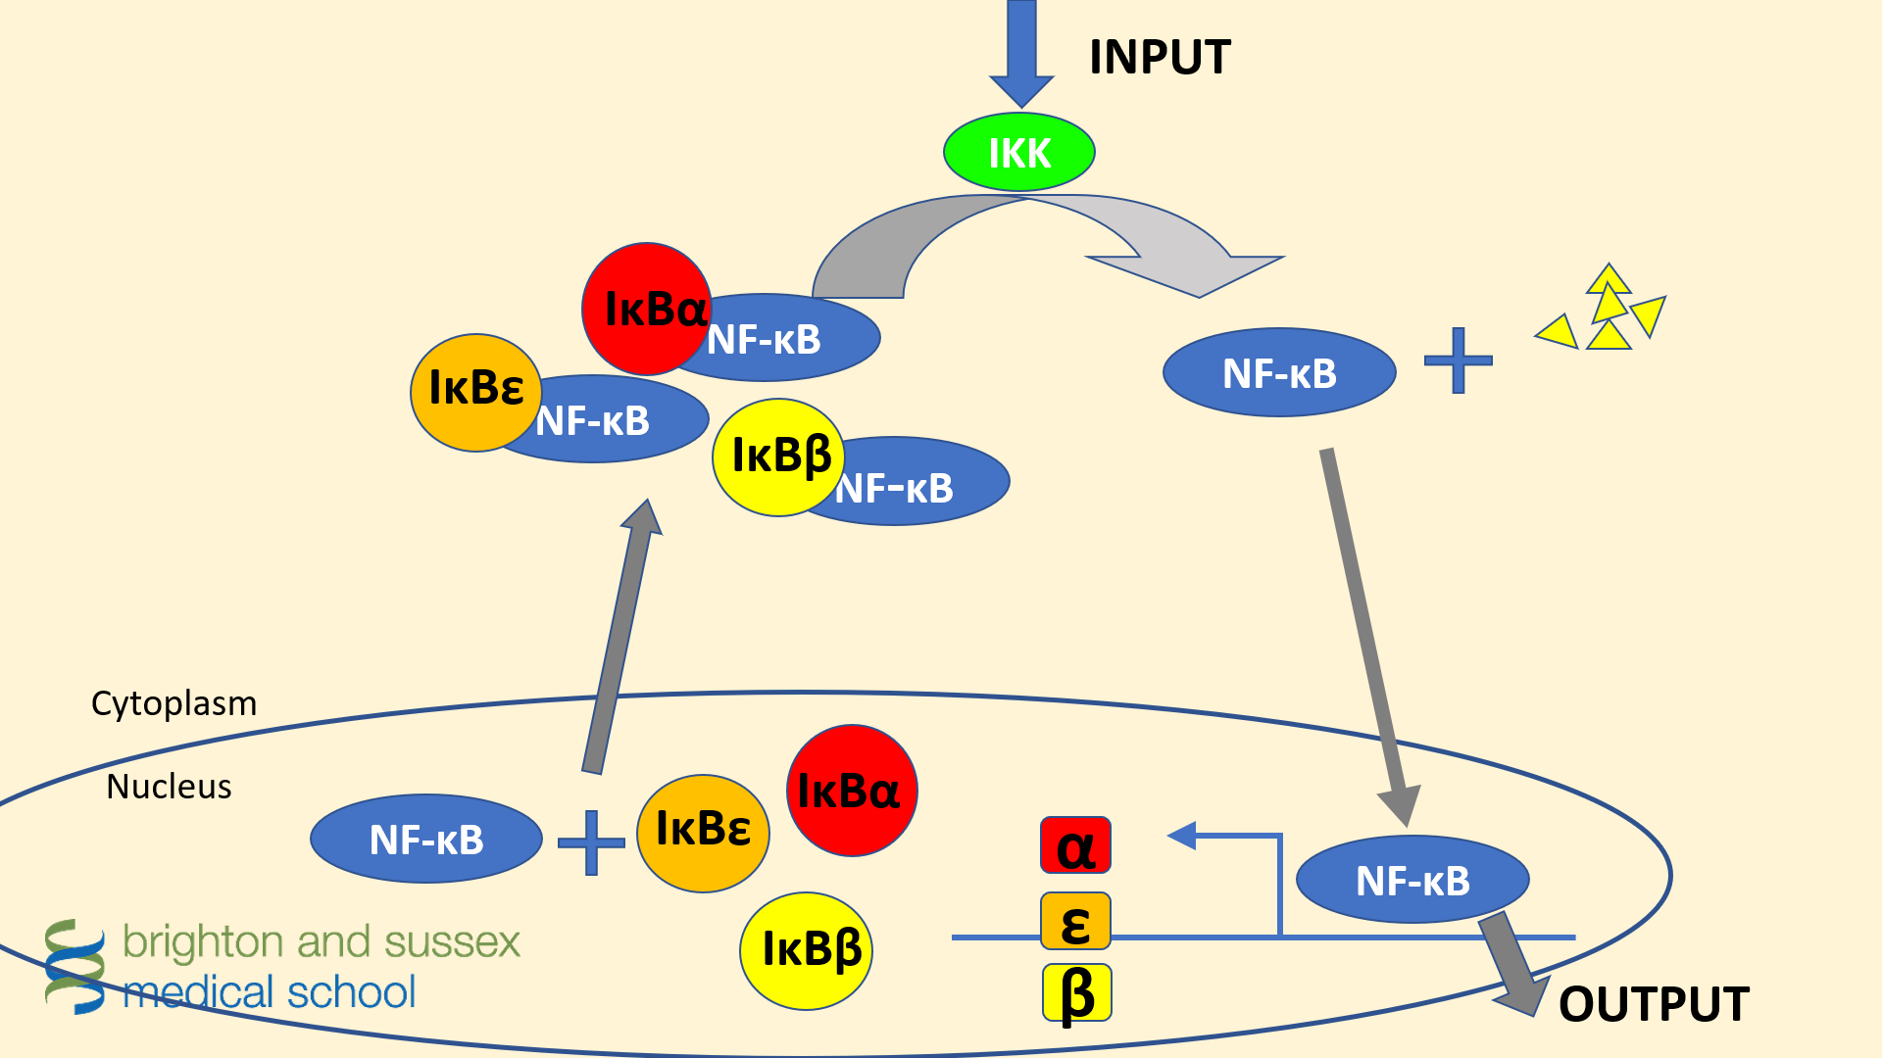
Hoffman et al. 2002
Three IκB Isoforms: IκBα IκBβ IκBε
Using the model, the authors show that IκBα gives strong negative feedback
IκBβ and IκBε reduce the amplitude of oscillations, eventually stabilising the level
Notes:
Main finding of paper: demonstrate some value of sysbio, we can gain insight about what the molecules contribute, with just kinetic parameter information.
This model contains knowledge that a bunch of parameters does not.
Get a more clear graph showing alpha beta and epsilon are here?

Slide 21
Hoffman et al. 2002
Notes:
Above is a healthy response to stimulation with
Why does it want to oscillate?

Slide 22
Hoffman et al. 2002
Removal of IκBβ and IκBε would keep the model oscillating indefinitely!
What other parameters might lead to chronic NFkB levels?

Slide 23
INPUT
IKK
IκBα
NF-κB
IκBε
NF-κB
NF-κB
IκBβ
NF-κB
Cytoplasm
Nucleus
IκBα
NF-κB
IκBε
α
NF-κB
IκBβ
ε
β
OUTPUT

Slide 24
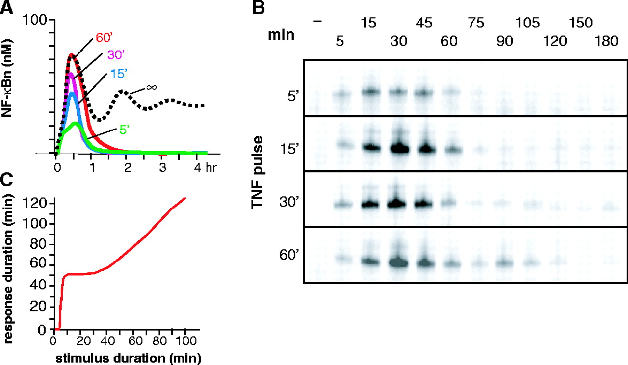
Why would nature go to all this trouble?
Bimodal Signalling!
Short bursts of stimulation result in roughly 1 hour of NF-κBn activity.
Stimulation for longer than 60’ gives a signal proportional to the stimulus duration.
Notes:
We get a minimal burst of 1 hour, which gives time for the NF-κB target genes to express and mount an appropriate immune response.
It’s somewhat disputed, but: Oscillations control which genes are expressed. In Hoffman et al. 2002,

Slide 25
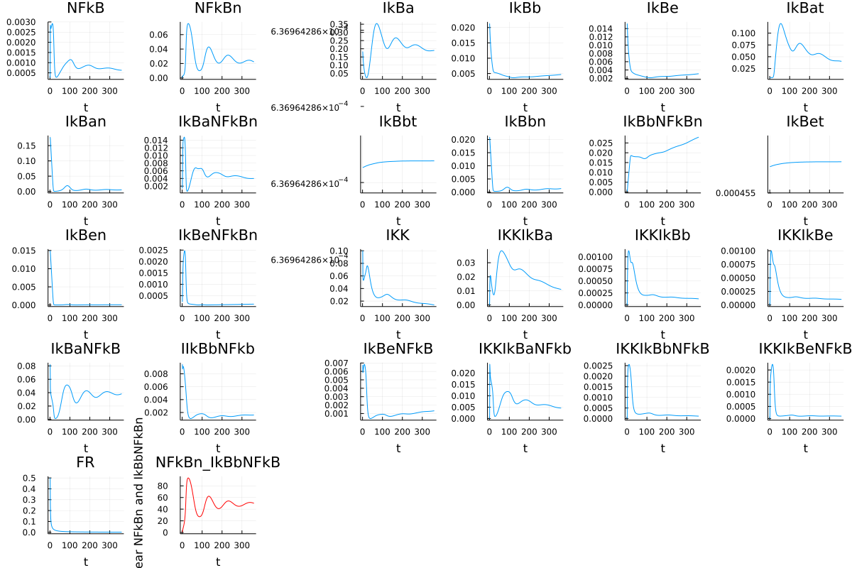
IKK
Notes:
The order is bad. No upstream -> downstream flow. IKK is not at the start for some reason?
This system is complex!! In order to experimentally verify our predictions we’d need:
An antibody (wouldn’t have one for every species)
Proteomics (doesn’t show what’s bound)
RNA sequencing (only shows expression, not location/what’s bound)

Slide 26
Healthy Response
Notes:
This system is complex!!
Everything needs to work to get this last graph! If it didn’t look like this, the last graph wouldn’t.

Slide 27
Please log in to mitchell.science/teaching
…and open
“hoffman2002 2023.ipynb”

Slide 28
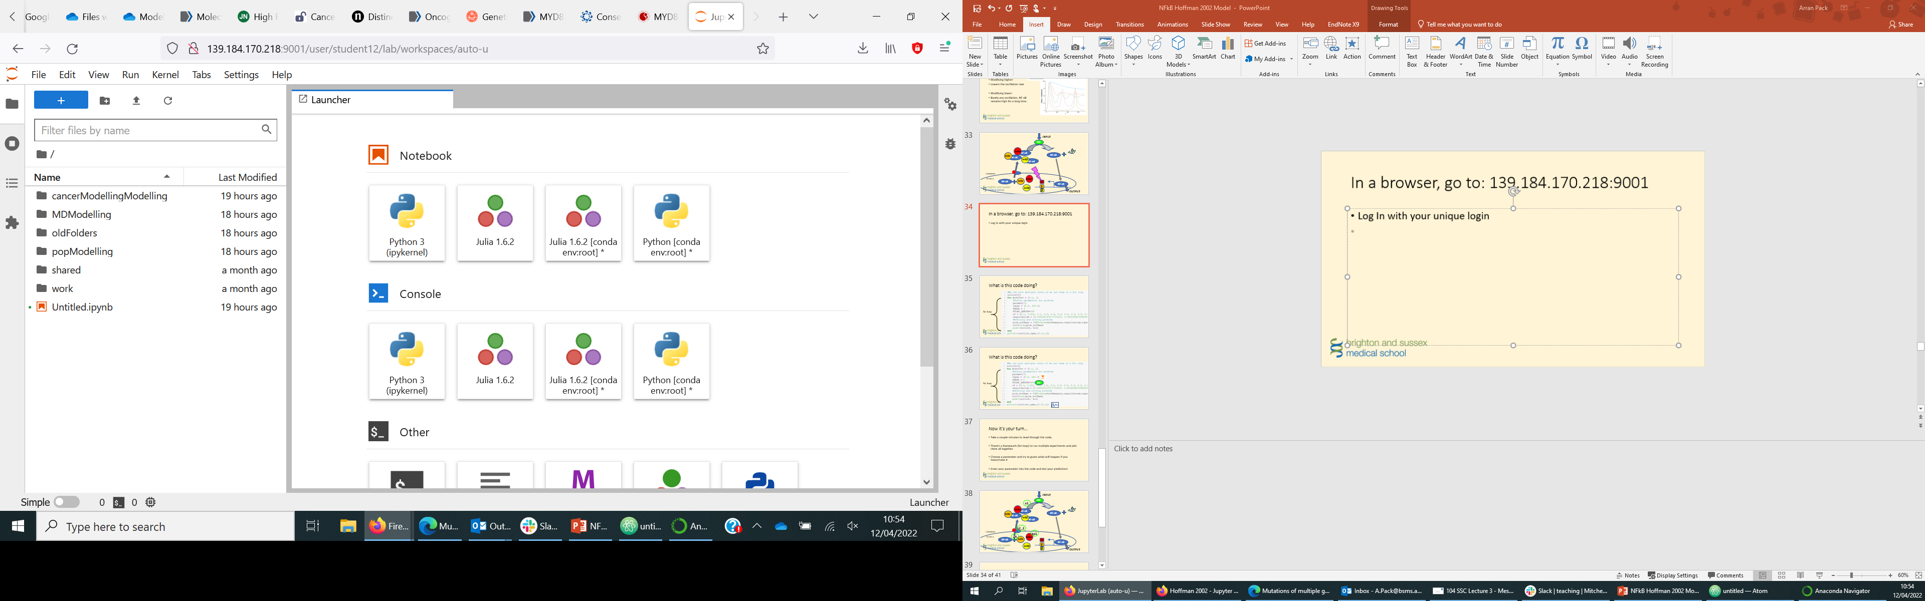
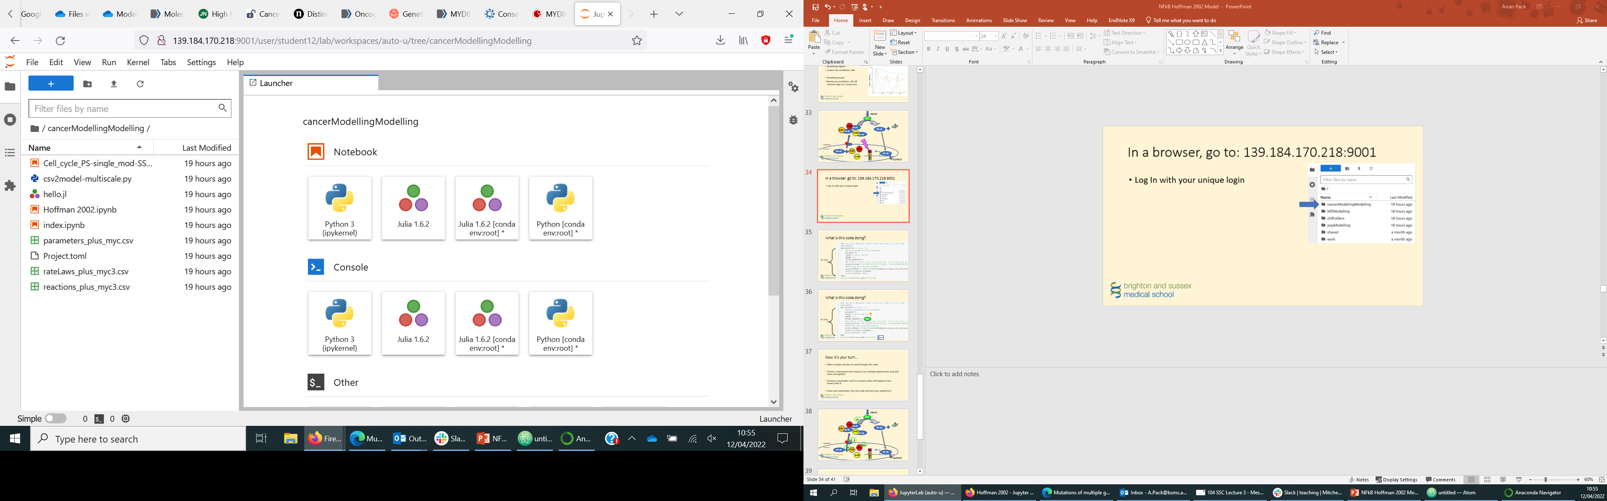
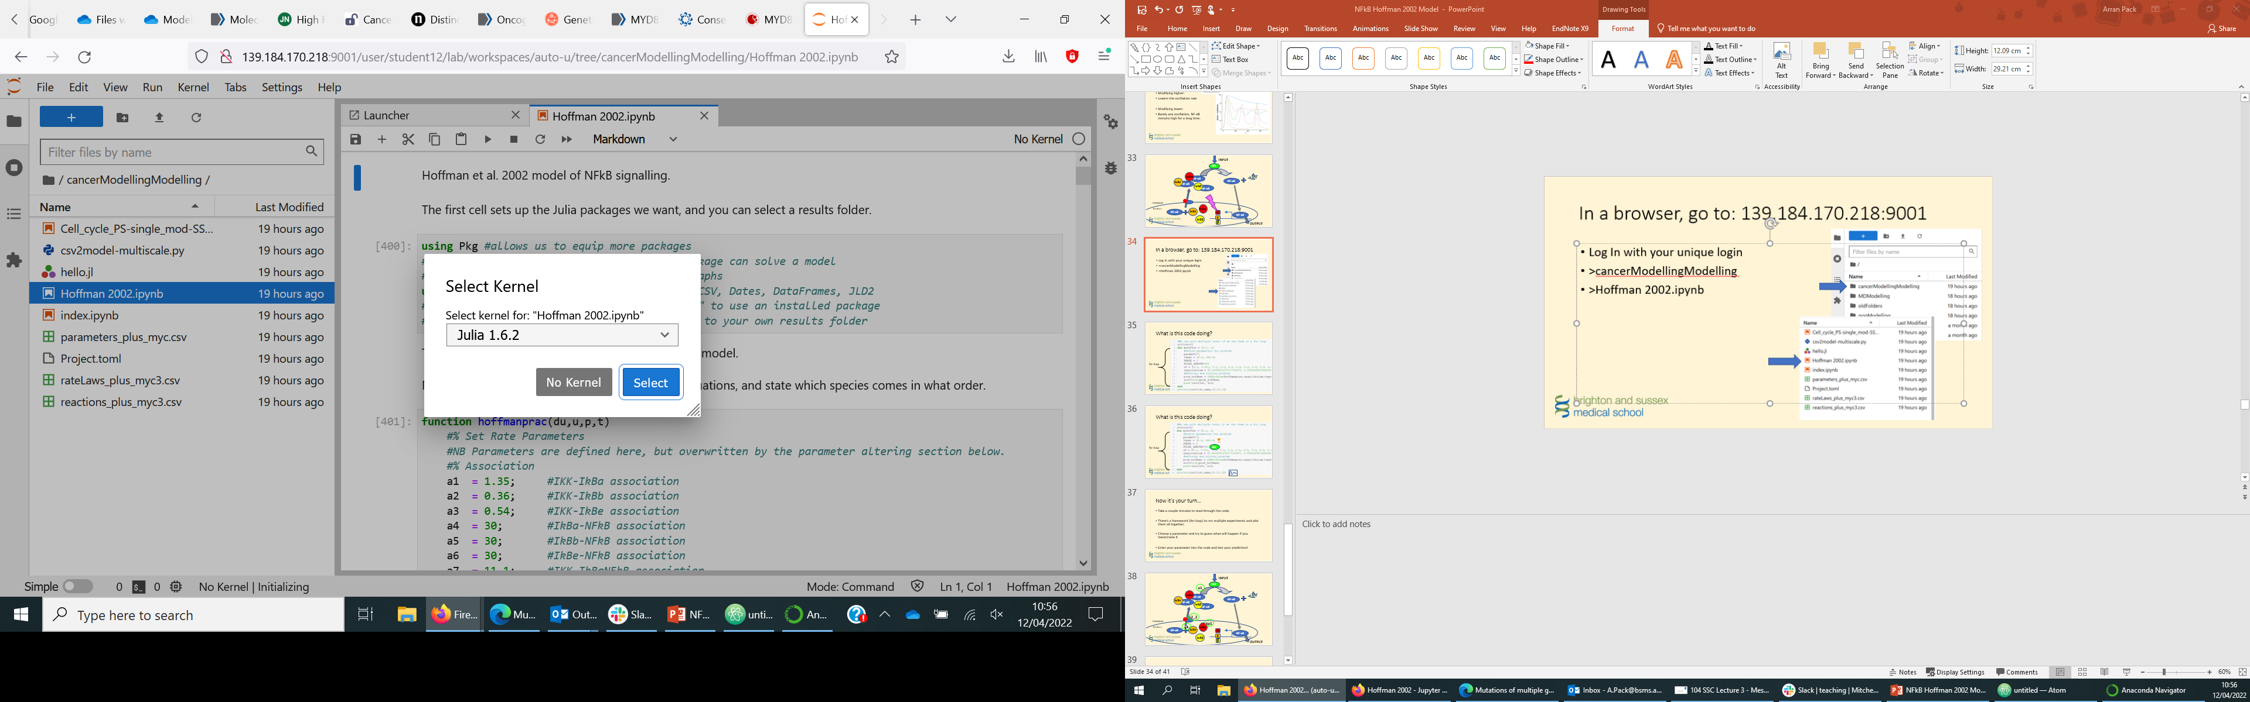
In a browser, go to: Mitchell.science/teaching
Log In with your unique login
>cancerModellingModelling
>Hoffman2002 2023.ipynb
>Julia 1.6.2

Slide 29
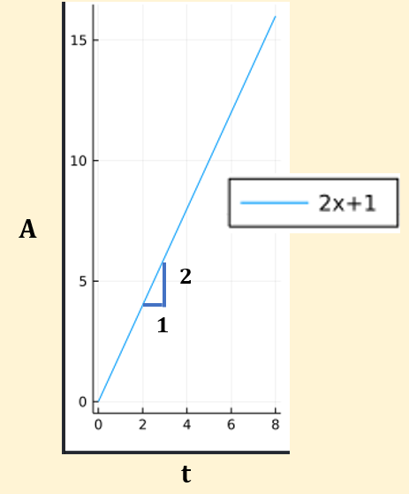
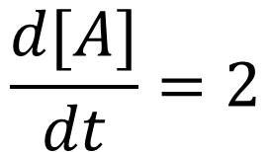

Ordinary Differential Equation
$$\frac{d[A]}{dt}=2$$
$$A$$

Slide 30
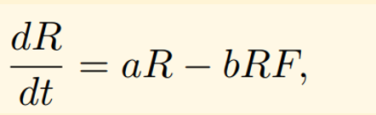
Methods
Models consist of Ordinary Differential Equations
Individual equations are simple: bind and unbind at different rates
Notes:
Number of Rabbits over time changes, where a is birth of rabbits, b is death rate of rabbits when rabbits + foxes encounter.
A protein
When S binds to E it uses up S so we have a negative term proportional to the amount of S and E
When the complex unbinds it creates more S so we have a positive proportional to the amount of C.
Verbally explain that substrate + Enzyme. If we changed the k1 rate, then we change the parameter.
Purpose is of an ODE is to show how something changes over time.

Slide 31
Methods
Models consist of ODEs
We code them in the Julia programming language
We solve them automatically and generate dynamic concentrations for everything we model
Individual equations are simple: bind and unbind at different rates
Complexity comes from many interacting reactions
Notes:
When S binds to E it uses up S so we have a negative term proportional to the amount of S and E
When the complex unbinds it creates more S so we have a positive proportional to the amount of C.
Verbally explain that substrate + Enzyme. If we changed the k1 rate, then we change the parameter.
Purpose is of an ODE is to show how something changes over time.

Slide 32
Methods
$$Protein A=production rate −reduction rate$$

Slide 33
Methods
$$Protein A=production rate −reduction rate$$

Slide 34
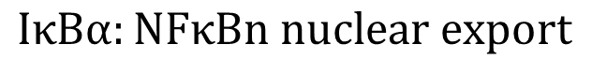
Methods
$$IkBa:NFkBn dissociation rate$$
$$\frac{d[IκBα:NFκBn]}{dt}=a4 ∗IκBαn ∗NFκBn −d4 ∗IκBαNFκBn −k2 ∗IκBαNFκBn$$
$$IκBαn+NFκBn association rate$$
$$IκBα:NFκBn nuclear export$$
$$Protein A=production rate −reduction rate$$
Notes:
Equation for the complex of IkBa:NFkBn .
Molecule level rises when IkBalpha and NFkBn associate
Level decreases when they naturally dissociate
Change this for a non-complex: du[7] = tp1 * IkBa - tp2 * IkBan - a4 * IkBan * NFkBn + d4 * IkBaNFkBn;

Slide 35
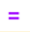
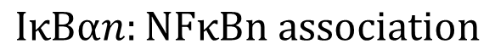
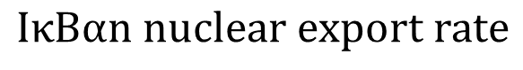
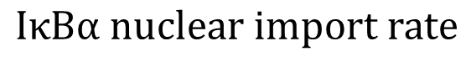
Methods
$$IκBαn nuclear export rate$$
$$IκBαn:NFκBn dissociation rate$$
$$\frac{d[IκBαn]}{dt}=tp1 ∗IκBα −tp2 ∗IκBαn −a4 ∗IκBαn ∗NFκBn+d4 ∗IκBαNFκBn$$
$$IκBα nuclear import rate$$
$$IκBαn:NFκBn association$$
$$Protein A=production rate −reduction rate$$
Notes:
Equation for the complex of IkBa:NFkBn .
Molecule level rises when IkBalpha and NFkBn associate
Level decreases when they naturally dissociate

Slide 36
Disease Model
We are modelling a tiny part of the cell, but:
We know a chronic NF-κB response is very bad
We can disturb the healthy model and see what produces a chronic NF-κB phenotype
Changing a parameter could represent:
A mutation in that protein
A drug binding to a protein

Slide 37
INPUT
IKK
IκBα
NF-κB
IκBε
NF-κB
NF-κB
IκBβ
NF-κB
Cytoplasm
Nucleus
IκBα
NF-κB
IκBε
α
NF-κB
IκBβ
ε
β
OUTPUT
Notes:
Need a pointer to the parameters in an equation, demonstrate that one is going higher or lower. Twisting knob dial?
Inducible IκBα mRNA transcription
tr2

Slide 38

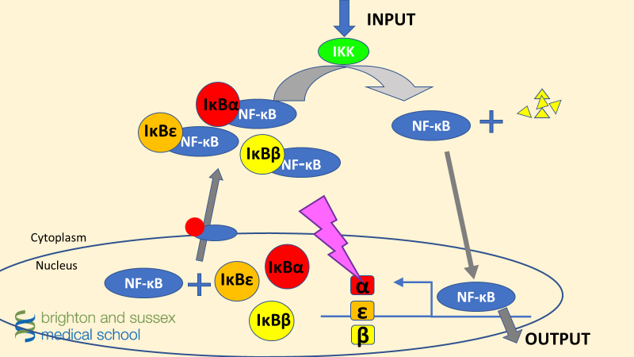
Notes:
Need a pointer to the parameters in an equation, demonstrate that one is going higher or lower. Twisting knob dial?

Slide 39
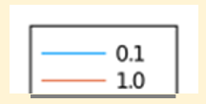
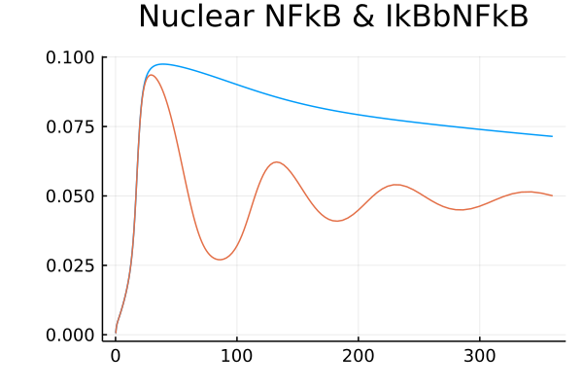
Parameter Change:
Modifying lower:
Barely any oscillation, NF-κB remains high for a long time.
Is this a driver mutation?
Notes:
What parameter could this be? Which molecules might you try to use to produce this?
Param is: Inducible IκBα mRNA transcription
tr2

Slide 40
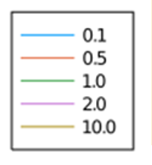
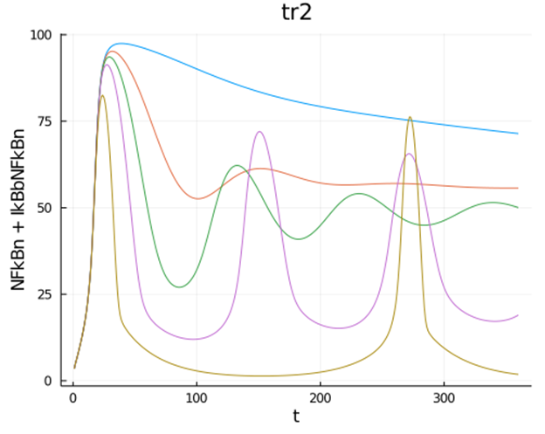
Parameter Change:
Modifying higher:
Lowers the oscillation rate
Modifying lower:
Barely any oscillation, NF-κB remains high for a long time.
Notes:
What parameter could this be? Which molecules might you try to use to produce this?
Param is: Inducible IκBα mRNA transcription

Slide 41
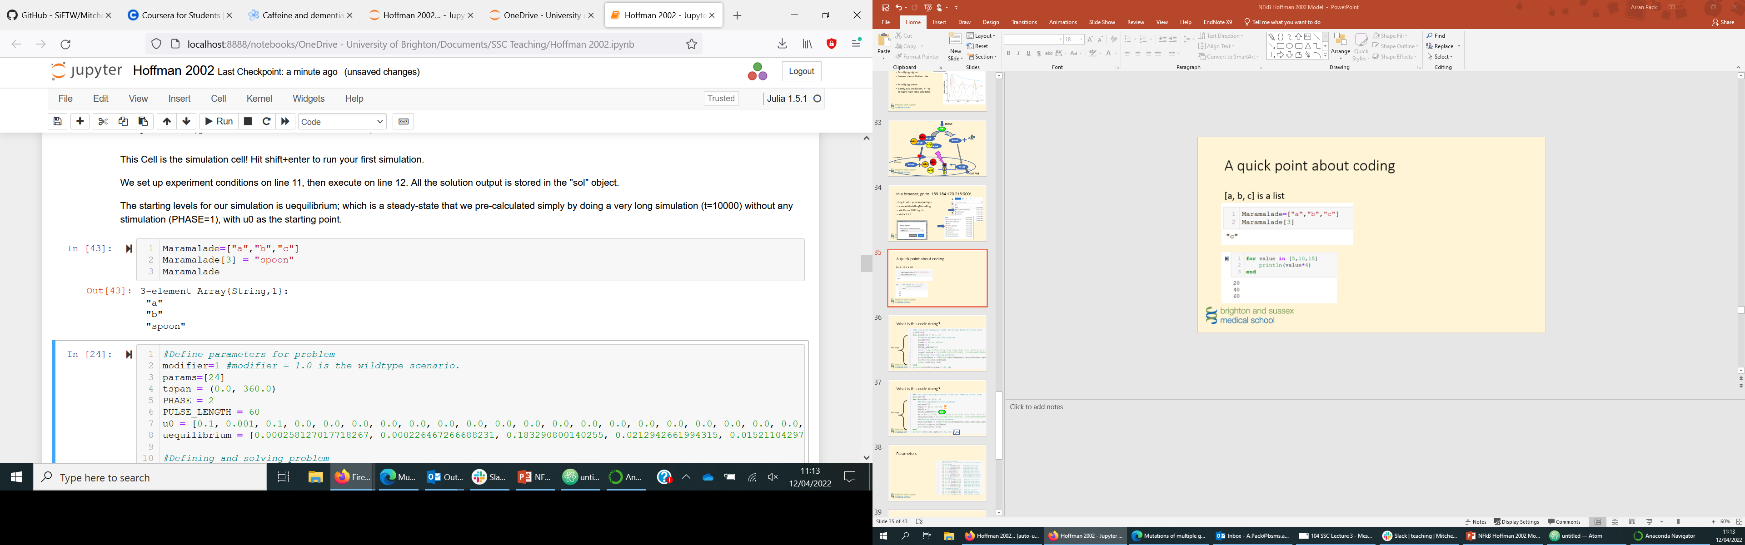
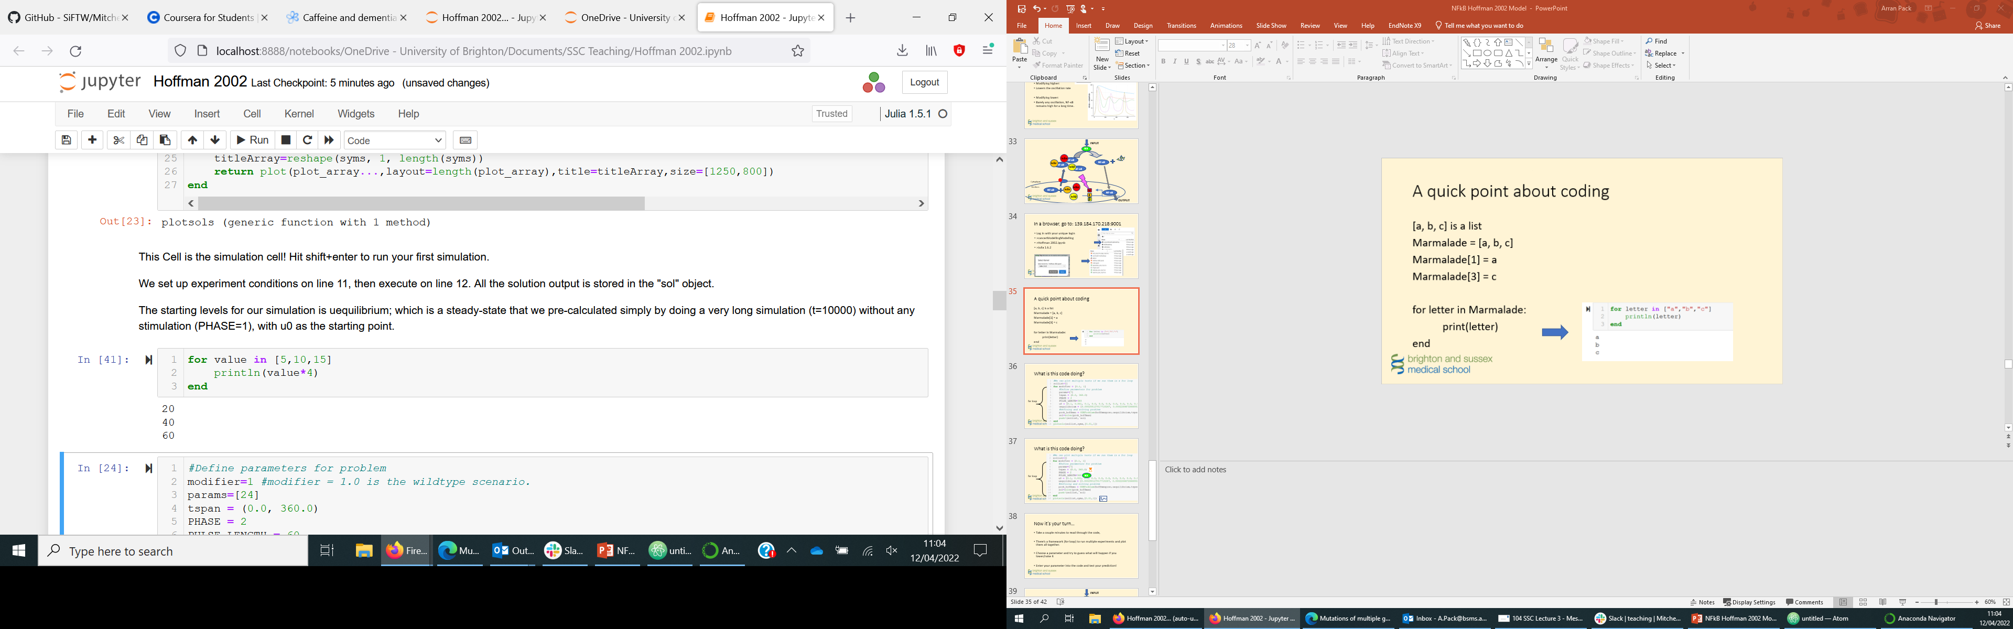
A quick point about coding
[a, b, c] is a list
We can edit a list
For loops repeat the inside, with a different “value” each time

Slide 42
Hoffman 2002 Model Needs:
Starting concentrations
Timespan of the experiment
PHASE = 2
Pulse Length – how long the antigen triggers IKK, input signal
Generate a “Problem” with the above
“Solve” command will run the simulation.

Slide 43
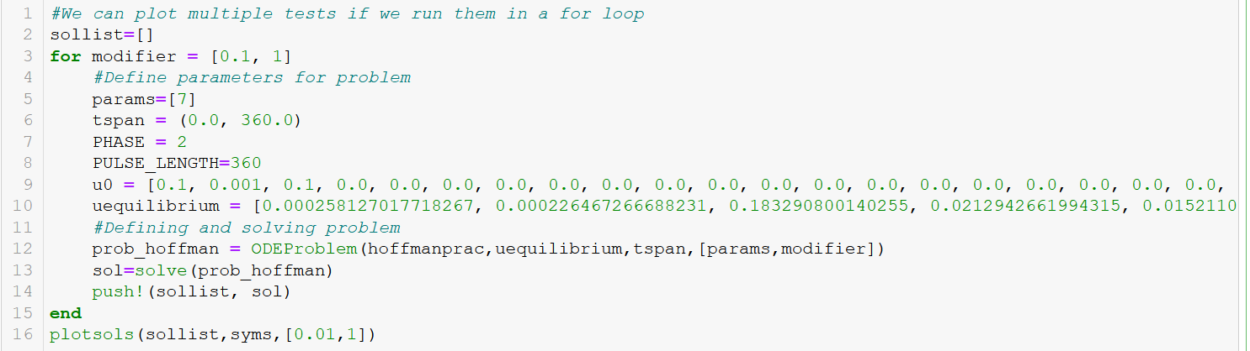

What is this code doing?
IKK
for loop

Slide 44
What is this code doing?

Slide 45
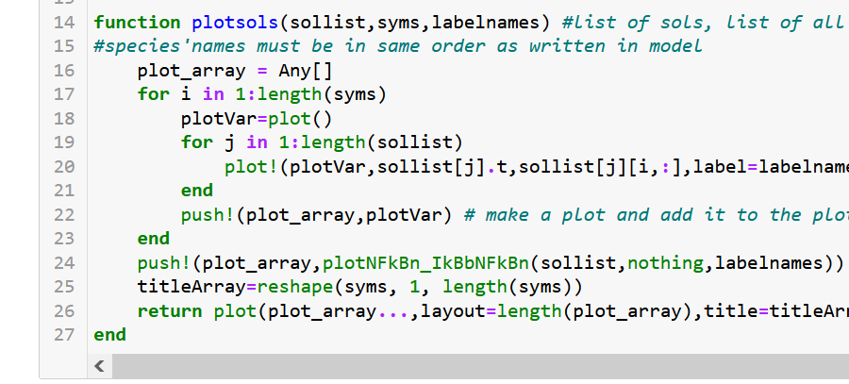
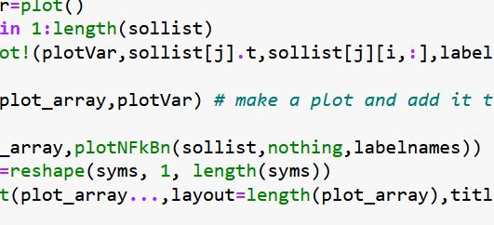
Do me a favour:
Delete this!

Slide 46
Now it’s your turn…
Take a couple minutes to read through the code,
There’s a framework (for loop) to run multiple experiments and plot them all together.
Choose a parameter and try to guess what will happen if you lower/raise it
Enter your parameter into the code and test your prediction!
Notes:
Screenshots of code!! We MUST go through what the hell code is. Show a for loop on a whiteboard:
For i=[1,2,3]
i*2
End
Output: 2, 4, 6

Slide 47
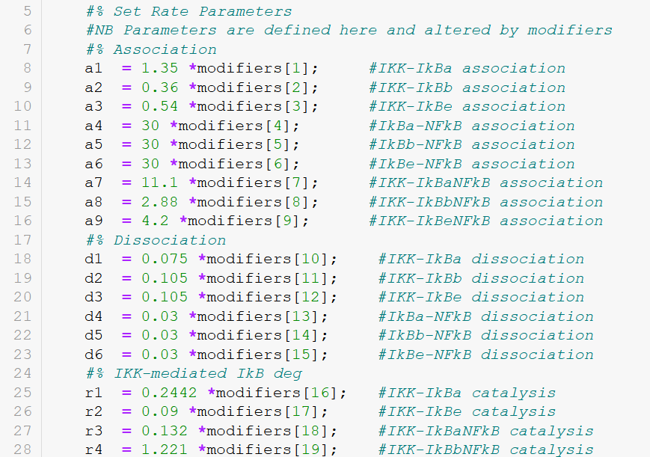
Parameters
Have names!
Are multiplied by modifiers!

Slide 48
INPUT
IKK
a1
IκBα
NF-κB
IκBε
NF-κB
NF-κB
IκBβ
NF-κB
k2_2
Cytoplasm
tp1
Nucleus
a4
IκBα
NF-κB
IκBε
α
NF-κB
IκBβ
ε
β
OUTPUT

Slide 49
Now it’s your turn… PART 2
Did you raise or lower your NF-κBn?
Is this autoimmunity or immunodeficiency?
Can you fix the mutant by changing another parameter?
Try multiple modifiers

Slide 50
Fix your mutant!

Slide 51
Review
Did you raise NF-κB ? Or lower it?
If it was already raised, how could you lower a parameter?
If it looks like X, Y happens is that worse or better?
Limitations of this model?
Notes:
The model’s main limitation: it’s very small! You won’t see cancer in this model. You will predict whether a mutation will raise NF-κB

Slide 52
